Slide 1
Cancer dependency
Week 3, Computational Genomics

Slide 2
Data arrgh Wrangling
“Wrangle a dataframe with columns KRAS expression, KRAS mutation status, and Cancer Type, and the rows represent cell lines.”
DepMap_ID | primary_disease
ACH-000001 | Ovarian Cancer
ACH-000002 | Leukemia
ACH-000003 | Colon/Colorectal Cancer
ACH-000004 | Leukemia
DepMap_ID | KRAS
ACH-000001 | 5.82
ACH-000002 | .18
ACH-000003 | 6.03
ACH-000004 | 2.59
Hugo_Symbol | DepMap_ID | Chr | Position
KRAS | ACH-000001 | 12 | 25..257
KRAS | ACH-000001 | 12 | 25..263
KRAS | ACH-000001 | 12 | 25..853
KRAS | ACH-000002 | 12 | 25..257

Slide 3
Data arrgh Wrangling
“Wrangle a dataframe with KRAS expression, KRAS mutation status, and Cancer Type as columns, and the rows represent cell lines.”
DepMap_ID | primary_disease
ACH-000001 | Ovarian Cancer
ACH-000002 | Leukemia
ACH-000003 | Colon/Colorectal Cancer
ACH-000004 | Leukemia
DepMap_ID | KRAS
ACH-000001 | 5.82
ACH-000002 | .18
ACH-000003 | 6.03
ACH-000004 | 2.59
DepMap_ID | n_KRAS_mutated
ACH-000001 | 3
ACH-000002 | 1

Slide 4
Data arrgh Wrangling
“Wrangle a dataframe with KRAS expression, KRAS mutation status, and Cancer Type as columns, and the rows represent cell lines.”
DepMap_ID | primary_disease | KRAS | n_KRAS_mutated
ACH-000001 | Ovarian Cancer | 5.82 | 3
ACH-000002 | Leukemia | .18 | 1
ACH-000003 | Colon/Colorectal Cancer | 6.03 | NA
ACH-000004 | Leukemia | 2.59 | NA

Slide 5
Data arrgh Wrangling
“Wrangle a dataframe with KRAS expression, KRAS mutation status, and Cancer Type as columns, and the rows represent cell lines.”
DepMap_ID | primary_disease | KRAS | n_KRAS_mutated | KRAS_mutated
ACH-000001 | Ovarian Cancer | 5.82 | 3 | TRUE
ACH-000002 | Leukemia | .18 | 1 | TRUE
ACH-000003 | Colon/Colorectal Cancer | 6.03 | NA | FALSE
ACH-000004 | Leukemia | 2.59 | NA | FALSE

Slide 6
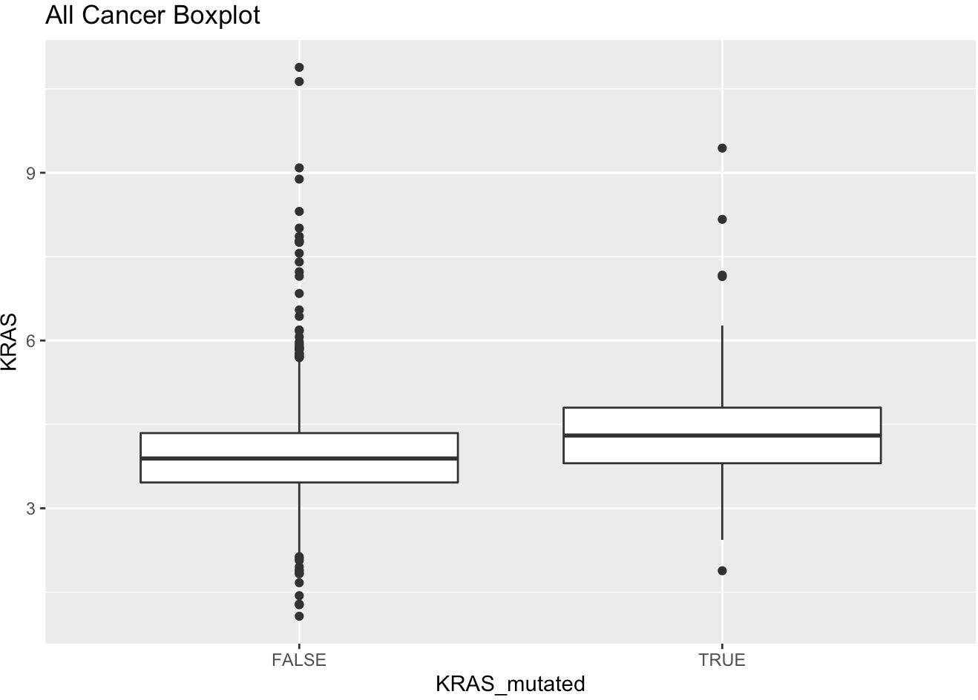
Data arrgh Wrangling
“Wrangle a dataframe with KRAS expression, KRAS mutation status, and Cancer Type as columns, and the rows represent cell lines.”

Slide 7
What can we follow-up with in this analysis?
Notes:
Is more KRAS protein “better” for cancer cells?
What are some follow-ups that can be examined?

Slide 8
Reverse vs. forward genetics
samples → variants → genes → cell types → processes → disease
samples → variants → genes → cell types → processes → disease
Notes:
Classical/Reverse genetics: given a disease phenotype, find its variant by mapping.
Forward genetics: start with sequence of the gene (perturb it?), and then find its function/phenotype
Could be taking healthy cells and figure out what transforms it into disease cells
Could be taking disease cells and finding out what transformations kills it
Forward genetics is possible only through the understanding what the human genome looks like! (knowing what you can perturb, understanding possible off targets)

Slide 9
Reverse vs. forward genetics
samples → variants → genes → cell types → processes → disease
Positional cloning, GWAS, computational techniques to determine driver genes
samples → variants → genes → cell types → processes → disease
CRISPR, siRNA
Notes:
Classical/Reverse genetics: given a disease phenotype, find its variant by mapping.
Forward genetics: start with sequence of the gene (perturb it?), and then find its function/phenotype
Could be taking healthy cells and figure out what transforms it into disease cells
Could be taking disease cells and finding out what transformations kills it
Forward genetics is possible only through the understanding what the human genome looks like! (knowing what you can perturb, understanding possible off targets)

Slide 10
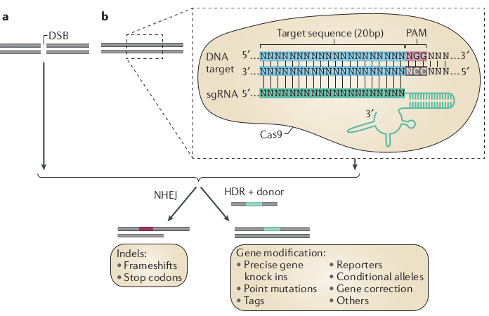
CRISPR-Cas9 System
Notes:
clustered regularly interspaced short palindromic repeats
A family of DNA sequences found in the genomes of bacteria. These sequences are derived from DNA fragments of bacteriophages that had previously infected the bacteria. They are used to detect and destroy DNA from similar bacteriophages during subsequent infections. Hence these sequences play a key role in the antiviral (i.e. anti-phage) defense system of prokaryotes and provide a form of acquired immunity.
DNA is destroyed via Cas9 endonuclease protein.
We have adapted the CRISPR system by using a synthetic guide RNA with 20bp spacer sequence similar to to these repeats, which attracts Cas9 protein to bind and cut at a region upstream of the PAM sequence.
NHEJ pathway - error prone but efficient
HDR pathway - precise but high fidelity (10%)
Applications of CRISPR-Cas9 system in cancer biology, Nat Rev Genetics, 2015

Slide 11
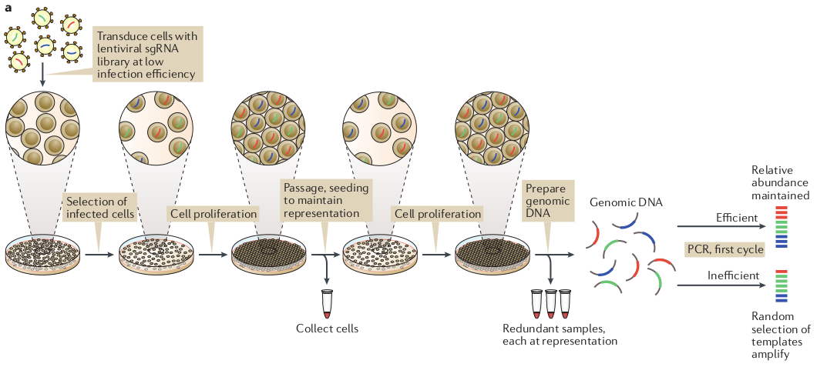
Experimental protocol
Notes:
A genome-wide library is created that targets all human genes in viral vectors, and is infected in cell lines.
Within a cell line, each infected cell is targeted by one guide RNA of a particular gene.
Antibiotic resistance selection for infected cells
Low infection efficiency to make sure only one guide is given per cell.
Passaging to reseed a fraction of cells to maintain the entire pooled population representation. (ie. 500 cells per guide RNA)
For cells infected to target gene X, a measurement of did they proliferate or deplete after weeks of growth, which is measured relative to a controlled pool of plasmid pool of DNA for fold change.
Am I ready for CRISPR? A user guide to genetic screens, Nat Rev Genetics, 2018

Slide 12
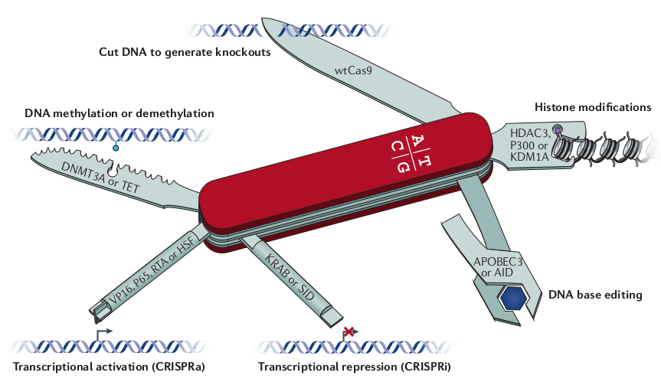
A CRISPR experiment: Perturbation, Model, Assay

Slide 13
A CRISPR experiment: Perturbation, Model, Assay
Cell lines
Mouse models
Xenograft models
Notes:
Cell lines produces a *lot* of cells

Slide 14
A CRISPR experiment: Perturbation, Model, Assay
Viability
Gene Expression
Notes:
Viability - for cells infected to target gene X, a measurement of did they proliferate or deplete after weeks of growth.

Slide 15
Dependency Map: genome-wide knockout, cancer cell lines, viability measurement
Some vocabulary:
The relative number of cells after CRISPR knock-out of gene X compared to no CRISPR knock-out is called the dependency score.
If this relative number is low, one says that the cell line is dependent on gene X: knock-out of gene X kills cancer cells.
If this relative number is high, one says that the cell line is not dependent on gene X*, and that the cell line is proliferating.
Dependency data = CRISPR data = Knockout data
Notes:
“Oncogenic Addiction” - reliance on a particular pathway or module.

Slide 16
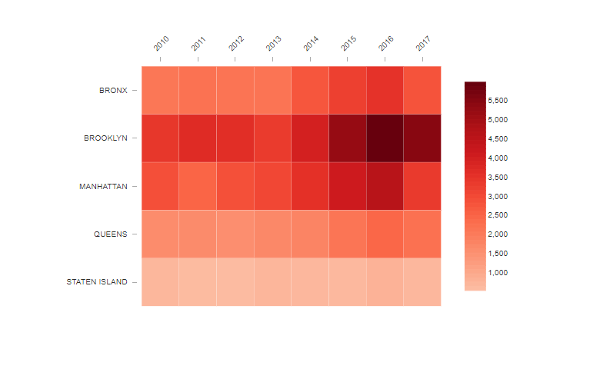
Dependency Map: genome-wide knockout, cancer cell lines, viability measurement
gene gene
1 2
Cell line 1
Cell line 2
Positive control: Essential genes - median values scaled to -1.
Negative control: Non-essential genes - median values scaled to 0.
Notes:
We look down vertically from the columns for each gene to get a sense of whether it is more depleted or proliferating.
(We can certainly look across cell lines and ask which gene is most dependent!)

Slide 17
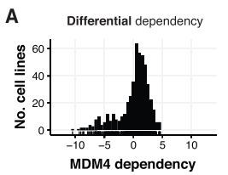
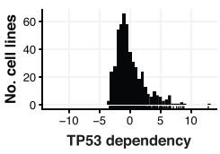
Dependency Map: genome-wide knockout, cancer cell lines, viability measurement
Notes:
If we knock out an oncogene, do we anticipate depletion or enrichment?
If we knock out a tumor suppressor gene, do we anticipate depletion or enrichment?
Defining a Cancer Dependency Map, 2017

Slide 18
How is dependency useful for precision medicine?
If patient has Bcr-Abl in CML, use Gleevec.
If patient has EGFR mutation in lung cancer, use gefitinib.
This is possible because researchers found a mutation, and then realized that there’s a drug that targets the gene’s mutation.
Notes:
Review: what’s the empirical vs. mechanistic approaches of cancer drug discovery?
What would be an mechanistic example that gefitinib fails to target EGFR mutation but looks like it “worked”?
The cell line is dependent on a different gene that happens to correspond to EGFR mutations
The cell line with EGFR mutation is sensitive to to the drug
The drug targets this other gene

Slide 19
How is dependency useful for precision medicine?
If patient has Bcr-Abl in CML, use Gleevec.
If patient has EGFR mutation in lung cancer, use gefitinib.
This is possible because researchers found a mutation, and then realized that there’s a drug that targets the gene’s mutation.
But this is under the mechanistic assumption that:
The cell line is dependent on the gene
The cell line is sensitive to the drug.
The drug targets a particular gene.
What would be an mechanistic example that gefitinib fails to target EGFR mutation but looks like it “worked”?
Notes:
What would be an mechanistic example that gefitinib fails to target EGFR mutation but looks like it “worked”?
The cell line is dependent on a different gene that happens to correspond to EGFR mutations
The cell line with EGFR mutation is sensitive to to the drug
The drug targets this other gene

Slide 20
Significance of dependencies: Identifying therapeutics
But this is under the assumption that:
The cell line is sensitive to a gene’s depletion.
Dependency can make sure that the cell line is sensitive to a gene’s depletion
The cell line is sensitive to the drug.
Examine drug sensitivity data.
The drug targets a particular gene.
Dependency can match drug sensitivity data with gene knockout
Notes:
Last week, we started to think about the following:
If patient has Bcr-Abl in CML, use Gleevec
If patient has EGFR in lung cancer, use gefitinib.
This was possible because researchers found a mutation, and then realized that there’s a drug that targets the gene.
But this is under the assumption that:
The drug targets a particular gene or pathway.
The cell line is sensitive to a gene’s depletion.
Having dependency data answers both:
Can match drug sensitivity data with gene knockout (association, not mechanism of how it works)
Can be sure that the cell line is sensitive to a gene’s depletion.
Would it be easier to target oncogenes or tumor suppressor genes?
Kinase inhibitors
The Cancer Dependency Map enables drug mechanism-of-action investigations, 2020

Slide 21
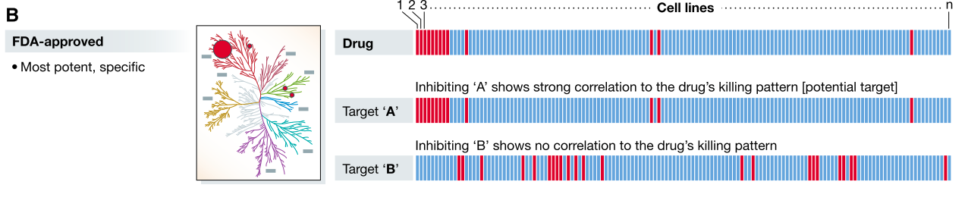
Significance of dependencies: Identifying therapeutics
But this is under the assumption that:
The cell line is sensitive to a gene’s depletion.
Dependency can make sure that the cell line is sensitive to a gene’s depletion
The cell line is sensitive to the drug.
Examine drug sensitivity data.
The drug targets a particular gene.
Dependency can match drug sensitivity data with gene knockout
Notes:
Last week, we started to think about the following:
If patient has Bcr-Abl in CML, use Gleevec
If patient has EGFR in lung cancer, use gefitinib.
This was possible because researchers found a mutation, and then realized that there’s a drug that targets the gene.
But this is under the assumption that:
The drug targets a particular gene or pathway.
The cell line is sensitive to a gene’s depletion.
Having dependency data answers both:
Can match drug sensitivity data with gene knockout (association, not mechanism of how it works)
Can be sure that the cell line is sensitive to a gene’s depletion.
Would it be easier to target oncogenes or tumor suppressor genes?
Kinase inhibitors
The Cancer Dependency Map enables drug mechanism-of-action investigations, 2020

Slide 22
samples → variants → dependent genes → cell types → processes → disease
Can genomics alone predict dependent genes? (without culturing cancer cell lines from patient samples and conducting a CRISPR experiment)
Can genomics alone predict candidate drugs to use? (without culturing cancer cell lines from patient samples and conducting a drug screen experiment)
Can CRISPR and drug sensitivity data help us understand how a drug’s target mechanism?
Notes:
Association vs. prediction - given a new patient sample + genomics, can we predict what gene dependency and drug sensitivity?
Todd Golub on precision medicine, I think

Slide 23
samples → variants → dependent genes → cell types → processes → disease
Patients would provide a blood sample or bit of tumor for molecular analysis, and then computational genomics predicts a list of drugs that are most likely to work, and a list of dependent genes the drug would target.
Notes:
Association vs. prediction - given a new patient sample + genomics, can we predict what gene dependency and drug sensitivity?
Todd Golub on precision medicine, I think

Slide 24
Drug sensitivity (Gefitinib)
Gene knock-out
(EGFR-mut)
Genomics
(EGFR-mut, lung cancer)

Slide 25
Drug sensitivity
(?)
Gene knock-out (KRAS-mut)
Genomics
(KRAS-mut, lung cancer)
Notes:
KRAS example.
If the gene knock-out/drug sensitivity isn’t necessarily the driver gene, it’s called synthetic lethality.
Ultimately, in precision medicine, we won’t be working with cell lines.
We are working with patient’s genomic profile, and there is no dependency or drug sensitivity data to figure out what genes are sensitive to knock-out, or what drugs target which gene.
Association vs. prediction - given a new patient sample + genomics, can we predict what gene dependency and drug sensitivity?
If we can build a model to predict dependency or drug sensitivity using genomic data, that’s powerful.

Slide 26
Drug sensitivity
(?)
Gene knock-out (WRN helicase)
Genomics
(Microsatellite instability)

Slide 27
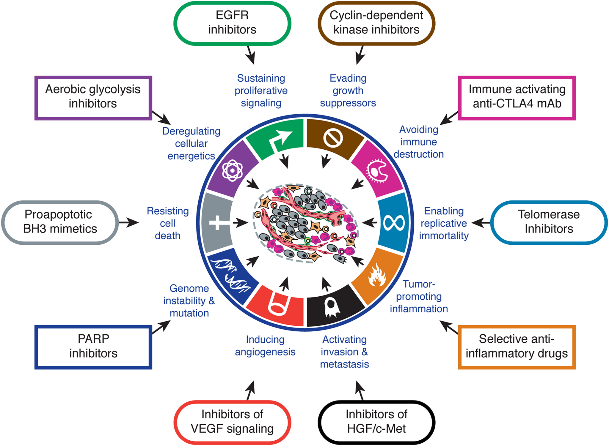
Notes:
Targeted cancer therapies

